Slide 1
Public Health Decision Making in a Radiation Emergency
Early Phase Response: 0-36 hours
Notes:
This module will provide a course overview. The estimated length of instruction is 4 hours.

Slide 2
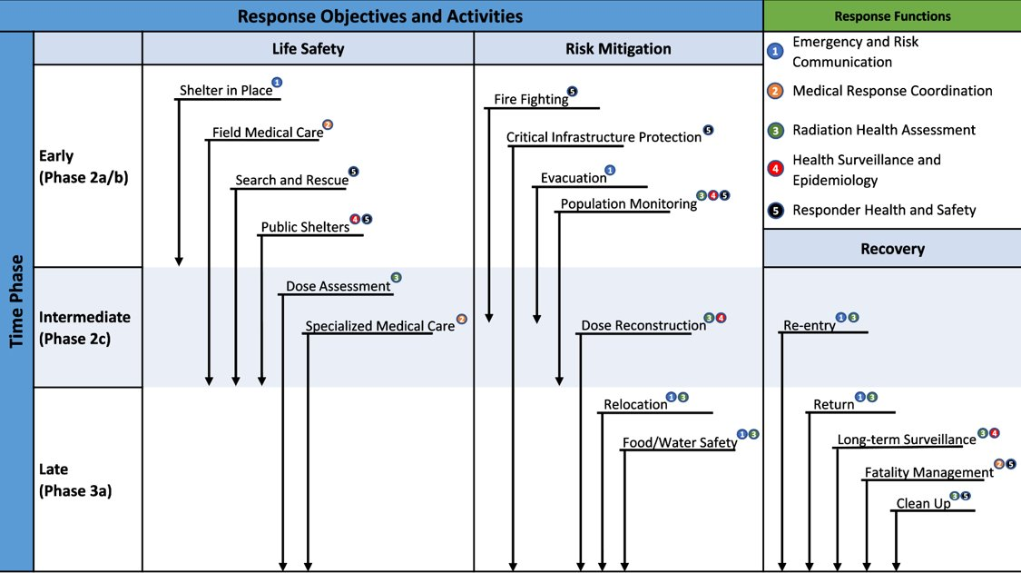
Response Objectives, Functions, and Activities
Notes:
Description of image: A diagram outlining the response objectives and activities by time phase for a radiation emergency. Outlines the early phase activities. This set of modules covers the early phase risk mitigation and recovery activities.

Slide 3
Module Overview: T+0 -> T+36hrs
Response Activities
Shelter-in-Place
Responder Health and Safety
Evacuation
Notes:
This module will focus on response activities that will be initiated in the first 12-48 hours. We will periodically review modeling products for current and future time periods to help shape our understanding of the operational environment and drive decision making.
ASSUMPTIONS INCLUDE:
During the initial 24-hour shelter-in-place period, responding agencies will retain some capacity for receiving damage reports and the Interagency Modeling and Atmospheric Assessment Center (IMAAC) data products, communicating/coordinating with partner agencies, and conducting response planning.
Planning for upcoming operations will begin prior to the target operational period. For example, planning for a response activity that is targeted for T+24hrs will be initiated no later than T+12hrs.
Planners will use current and projected IMAAC data products to drive response planning.
IMAAC data products will be updated as additional radiation measurements are taken at key locations.

Slide 4
Shelter-in-Place (SIP)
Phase: Early
Objective: Life Safety
Functional Area: Risk Communication
Notes:
This section explores SHELTER-IN-PLACE as an EARLY phase response activity. It falls under the LIFE SAFETY response objective. The public health functional area is RISK COMMUNICATION.
Assumptions for this section include:
The shelter-in-place order was promptly issued.
Emergency communications were received into most parts of the moderate damage zone.

Slide 5
Response Objectives, Functions, and Activities SIP
Notes:
Description of image: A diagram outlining the response objectives and activities by time phase for a radiation emergency. Outlines the early phase life safety activities.

Slide 6
SIP Learning Objectives
Identify the criteria to shelter-in-place for the public and responders.
Identify the factors that should be considered for responders to exit shelter safely.
Identify the factors that should be considered for members of the public to exit shelter safely.
Notes:
The learning objectives for this section are to identify factors that should be considered for:
Responders to safely exit shelter
Members of the public to safely exit shelter

Slide 7
SIP Relationships
Prerequisites
Pre-incident emergency communication planning
Concurrencies
Receipt of initial Interagency Modeling and Atmospheric Assessment Center (IMAAC) models
Dose assessment
Dependencies
Evacuation
Notes:
Prerequisites
Pre-incident emergency communications planning.
Concurrencies
Receipt of initial Interagency Modeling and Atmospheric Assessment Center (IMAAC) models
Dose assessment
Dependencies
Evacuation

Slide 8
Background: Protection Factor
Building protection factor (BPF) is a relative measure of radiation dose reduction.
BPF 10 → 1/10th of the radiation dose
BPF 200 → 1/200th of the radiation dose
Basements and interior rooms within multistory structures provide the optimum protection.
Vehicles and single-story wood frame houses provide limited shielding.
https://www.fema.gov/sites/default/files/documents/fema_nuc-detonation-planning-guide.pdf
Notes:
Description of image: Different types of buildings provide varying degrees of protective fallout shielding. An eight-story building provides better protection than smaller structures, especially in the center of the building or middle floors. A five-story building provides some protection, but the middle floors are the safest. single-story, two-story, and three-story buildings provide limited shielding. Brick and concrete buildings are superior shields than brick veneer buildings, which are superior to wood frame buildings. In all cases, the basement is the safest place in the building, especially if it is concrete.

Slide 9

Background: Sheltering
Seeking shelter is among the most crucial protective actions in the initial hours following a nuclear explosion.
Sheltering can be life-saving as it provides protection against radioactive fallout, safeguarding individuals from potential harm.
Individuals should plan to stay sheltered for a minimum of 12 to 24 hours.
Notes:
Description of image: Get Inside, Stay Inside, Stay Tuned icons. A person running to the door (Get Inside); a person and dog inside a house (Stay Inside); A person sitting on the couch listening to a radio (Stay Tuned).

Slide 10
Where would shelter-in-place be recommended?
Initial shelter-in-place order should include:
Light damage zone
Moderate damage zone
Hot Zone
Dangerous radiation zone
When in doubt, go big…
Information will be limited during the initial minutes/hours.
It will be easier to retract an SIP order than to expand one.
Notes:
While initial information is developing, shelter-in-place orders may go out to a very large area. As additional information is collected, the order may be lifted in certain areas.
Communication staff should utilize pre-scripted messages to quickly disperse the shelter-in-place messages to the public. Pre-scripted shelter-in-place messages can be found at:
https://www.cdc.gov/nceh/radiation/emergencies/resourcelibrary/infographics.htm
Also at fema_improvised-nuclear-device_communicating-aftermath_june-2013.pdf
See Public Safety and Protective Action Guidance Section:
https://www.fema.gov/sites/default/files/documents/fema_improvised-nuclear-device_communicating-aftermath_june-2013.pdf

Slide 11

What messages should be distributed immediately to responders and the public?
Improvised Nuclear Device Response and Recovery: Communicating in the Immediate Aftermath offers pre-scripted messages designed to address issues during the initial 72 hours of a radiation emergency.
Pre-scripted messages include:
SIP instructions
Decontamination instructions
Improvised Nuclear Device (IND) and Radiation basics
Customize the delivery and content of messages for diverse audiences, taking into consideration cultural sensitivities and accessibility requirements.
Notes:
Description of image: Get Inside, Stay Inside, Stay Tuned icons. A person running to the door (Get Inside); a person and dog inside a house (Stay Inside); A person sitting on the couch listening to a radio (Stay Tuned).
While initial information is developing, shelter-in-place orders may go out to a very large area. As additional information is collected, the order may be lifted in certain areas.
Communication staff should utilize existing messages to quickly disperse the shelter-in-place messages to the public. Existing shelter-in-place messages can be found at:
https://www.cdc.gov/nceh/radiation/emergencies/resourcelibrary/infographics.htm
See Public Safety and Protective Action Guidance Section:
https://www.fema.gov/sites/default/files/documents/fema_improvised-nuclear-device_communicating-aftermath_june-2013.pdf

Slide 12
Shelter-in-Place Partners
In addition to Public Health, these partners may have a role:
State/Local Elected Officials
Emergency Management
Radiation Control
Media Partners

Slide 13
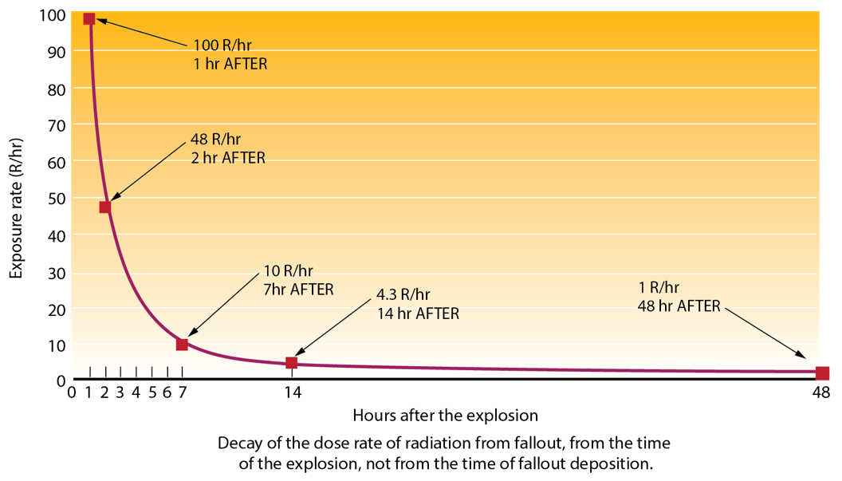
Dose Rate Decay After Detonation
Dose rate falls off rapidly with time
Falls by a factor of 10 in the first 7 hours
Another factor of 10 after 48 hours
Early shelter-in-place critical
Significant consideration for IND
Less so for nuclear power and radiological dispersal device (RDD) incidents
https://www.fema.gov/sites/default/files/documents/fema_nuc-detonation-planning-guide.pdf
Notes:
Description of image: A graph of the decay of fallout radiation from the time of detonation, with dose rate (R/hr) as the y-axis and hours after explosion as the x axis. The initial curve is steep, dropping from 1000 R/hr at 1 hour, to 480 R/hr at 2 hours, and 100 R/hr at 7 hours. After this steep decline, it largely levels out, dropping from 43 R/hr at 14 hours to 10 R/hr at 48 hours.
Significant consideration for IND, but less so for nuclear power and RDD incidents

Slide 14
What factors should be considered for the general public to exit shelter safely?
Members of the public should be encouraged to shelter-in-place until:
Dose rates fall below 10 mR/hr.
Dose rates fall below 10 R/hr and evacuation routes cleared, facilitating the efficient transportation of individuals to regions with lower background radiation.
Public messages should be succinct, timely, precise, and conveyed with empathy.
Messages should be disseminated through diverse communication channels, encompassing radios, televisions, computers, mobile devices, and other applicable tools.
Emergency officials should tailor message delivery and content to cater to diverse audiences taking into account cultural nuances and accessibility requirements.
Notes:
MODERATOR ASK: What types of messages should the public receive about evacuation?
Emergency officials will need to provide information to the public on evacuation and sheltering. The information needs to include location and route to shelters and transportation options to shelters. The public should be informed that they will be stopped at a “check point” to wash radioactive material from their vehicles and emergency responders must remove radiation from themselves, their family and their pets before they can enter a shelter. The public should be told to bring quickly pack important papers, necessary medicines and a change of clothes. The public will also need to know about options for evacuating and sheltering with their pets. Improvised Nuclear Device Response and Recovery: Communicating in the Immediate Aftermath ; See Public Safety and Protective Action Guidance Section https://www.fema.gov/sites/default/files/documents/fema_improvised-nuclear-device_communicating-aftermath_june-2013.pdf)
What challenges and issues might you encounter when delivering these messages?
Trust
Credibility
Delivering short, action-based messages and strategizing to build credibility and trust impacts the effectiveness of messaging. Emergency officials should adapt message delivery and context for different audiences to address cultural and accessibility needs. Cultural groups often develop, identify with, and trust their own institutions, such as faith-based organizations, nongovernmental organizations, and political organizations. Take into account that some cultural groups have had different experiences with government agencies and organizations and some may be more ambivalent in accepting your messages. Consider partnering with these groups to disseminate messages.
Relevant, credible, and culturally appropriate messaging in an emergency offers audiences the information they need to make lifesaving decisions.

Slide 15
What factors should be considered for responders to safely exit shelter?
To enhance effectiveness in the subsequent response, first responders must shelter-in-place until:
Dose rates drop below 10 R/hr
If possible, waiting longer for dose rates to drop further would be prudent.
While responders take shelter in the radiation hazard area, individuals in unaffected areas will be mobilized to initiate response activities, including:
Firefighting
Search and Rescue
Protecting Critical Infrastructure
Field Medical Operations

Slide 16
SIP Resources

Slide 17
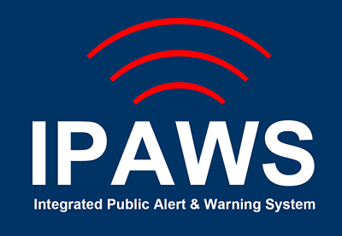
IPAWS
The Integrated Public Alert & Warning System (IPAWS) serves as FEMA's national platform for local alerting. It delivers authenticated emergency and life-saving information to the public through various channels, including mobile phones using Wireless Emergency Alerts, radio and television via the Emergency Alert System, and the National Oceanic and Atmospheric Administration's Weather Radio.
https://www.fema.gov/emergency-managers/practitioners/integrated-public-alert-warning-system
Notes:
Description of image: Integrated Public Alert & Warning System [IPAWS] logo

Slide 18
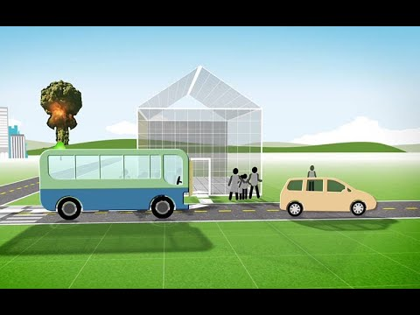
Video: Where to Go in a Radiation Emergency
To safeguard yourself during a radiation emergency, adhere to the principles of Go Inside, Stay Inside, and Stay Tuned. This animated infographic guides you on appropriate shelter locations and illustrates the crucial steps to follow for your protection.
https://www.youtube.com/watch?v=ux8trcUoCC8
Notes:
Description of image: Video: Where to Go in a Radiation Emergency. CC available.
https://www.youtube.com/watch?v=ux8trcUoCC8

Slide 19

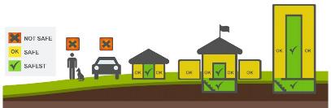
CDC Radiation Emergency Toolkit for Public Health Professionals
Offers fact sheets and infographics designed to effectively communicate protective actions to the public.
Delivers training sessions focused on enhancing risk communication skills in the context of a radiation emergency.
https://www.cdc.gov/nceh/radiation/emergencies/publichealthtoolkit.htm
Notes:
Description of images: Get Inside, Stay Inside, Stay Tuned icons. A person running to the door (Get Inside); a person and dog inside a house (Stay Inside); A person sitting on the couch listening to a radio (Stay Tuned).
Illustration of shelter effectiveness. Go to the basement or the middle of the building. Radioactive material settles on the outside of buildings; so the best thing to do is stay as far away from the walls and roof of the building as you can.
The CDC Radiation Studies Section created infographics to help communicate protective actions to the public. These products can be used by risk communicators to craft and issue prompt protective action messages.
https://www.cdc.gov/nceh/radiation/emergencies/publichealthtoolkit.htm
In addition, the Radiation Emergencies website has educational videos and communications tools for use by state/local partners.
Radiation Emergency Training, Education, and Tools | Radiation Emergencies | NCEH | CDC

Slide 20
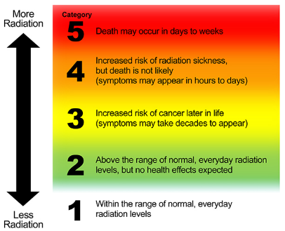
CDC Radiation Hazard Scale
Conveys the comparative hazards of radiation without delving into technical measurements or units.
Intended exclusively for utilization in radiation emergencies to convey initial recommendations for protective actions.
https://www.cdc.gov/nceh/radiation/emergencies/radiationhazardscale.htm
Notes:
Description: Image of CDC Radiation Hazard Scale. The Radiation Hazard Scale is intended to communicate relative hazards to populations under emergency conditions when exact radiation exposure parameters for specific individuals are not available. Category 5 (red) means that radiation doses are dangerously high and potentially lethal.
Category 4 (orange) means that radiation doses are dangerously high and can make people seriously ill.
Category 3 (yellow) means that radiation doses are becoming high enough where we may expect increased risk of cancer in the years ahead for people who are exposed.
Category 2 (green) means that radiation levels in the environment are higher than the natural background radiation for that geographic area.
Category 1 (white) means that radiation levels in the environment are within the range of natural background radiation for that geographic area.
The CDC Radiation Hazard Scale is a risk communications tool that can be used to drive protective actions. The tool can be adapted to maps to help communicate short-term risk from radiation exposures.
https://www.cdc.gov/nceh/radiation/emergencies/radiationhazardscale.htm

Slide 21
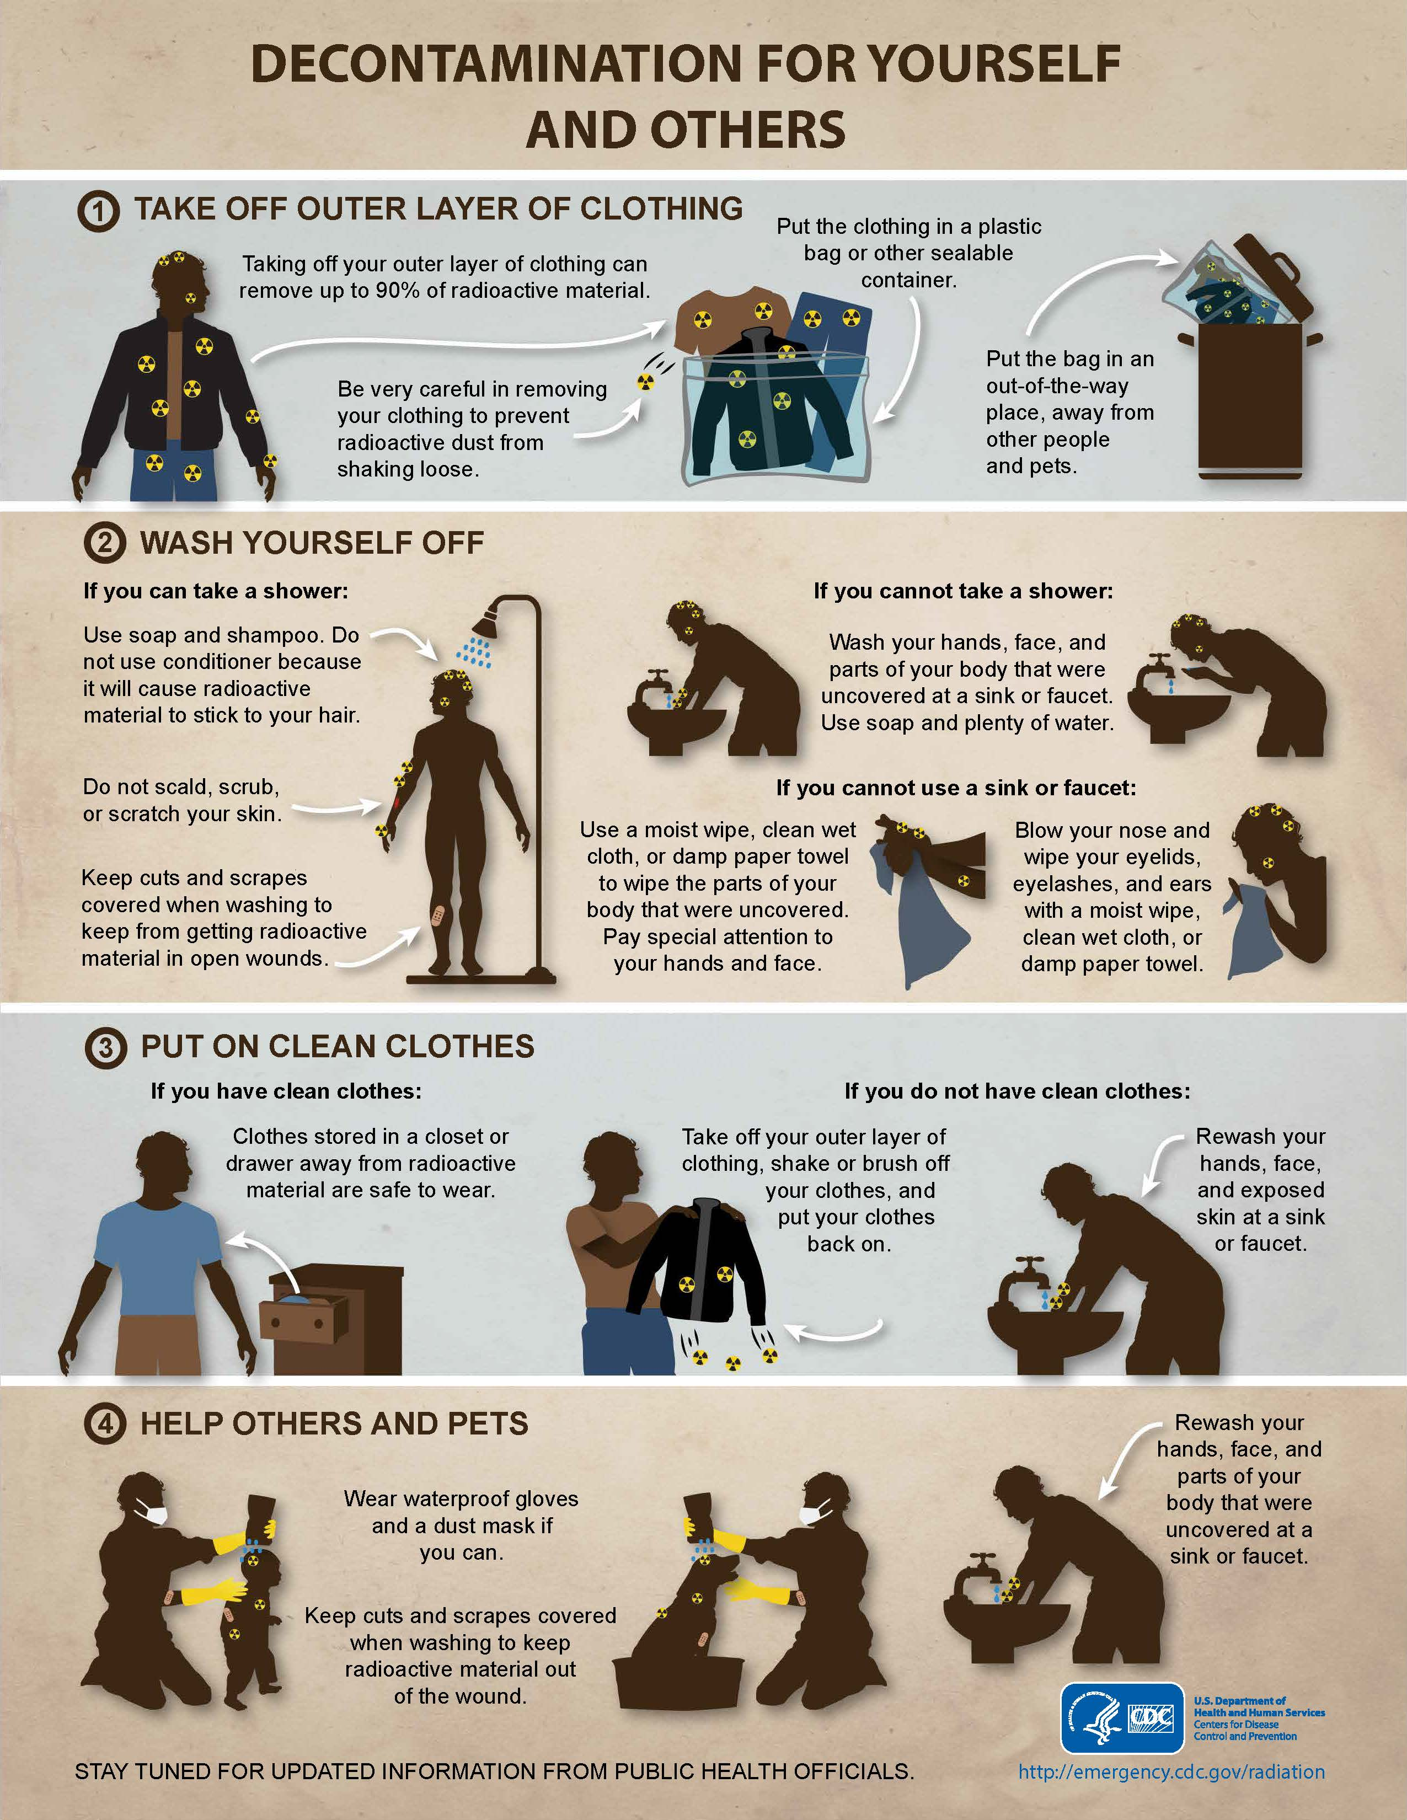
CDC Decontamination Infographic
An infographic outlining the steps for self or mutual decontamination.
Available in multiple languages
https://www.cdc.gov/nceh/radiation/emergencies/resourcelibrary/infographics.htm
Notes:
Description of Image: An infographic detailing how to decontaminate yourself or someone else. 1. Take off your outer layer of clothes 2. Wash yourself off. 3. Put on clean clothes. 4. Help Others and Pets.
https://www.cdc.gov/nceh/radiation/emergencies/resourcelibrary/infographics.htm

Slide 22
SIP References

Slide 23
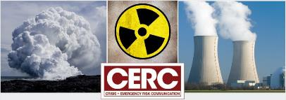
CDC Crisis & Emergency Risk Communication
(CERC)
Be First
Be Right
Be Credible
Express Empathy
Promote Action
Show Respect
https://emergency.cdc.gov/cerc/
Notes:
Description of image: CDC Crisis & Emergency Risk Communication logo
The CERC Radiation Emergencies quick reference sheet provides tips for crafting emergency risk communications and addressing concerns of the target audience.
Crisis & Emergency Risk Communication (CERC)|CDC

Slide 24
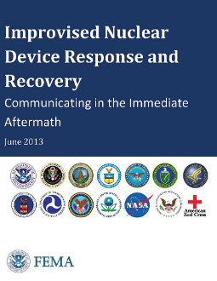
Improvised Nuclear Device Response and Recovery: Communicating in the Immediate Aftermath
This guide provides pre-scripted messages crucial for saving lives during a response to a nuclear explosion.
Messages have been pre-approved by the interagency.
New version coming soon!
https://www.fema.gov/sites/default/files/documents/fema_improvised-nuclear-device_communicating-aftermath_june-2013.pdf
Notes:
Description of image: Cover of Guide: Improvised Nuclear Device Response and Recovery: Communicating in the Immediate Aftermath
https://www.fema.gov/sites/default/files/documents/fema_improvised-nuclear-device_communicating-aftermath_june-2013.pdf
See Public Safety and Protective Action Guidance Section
May want to add that it is currently being updated

Slide 25
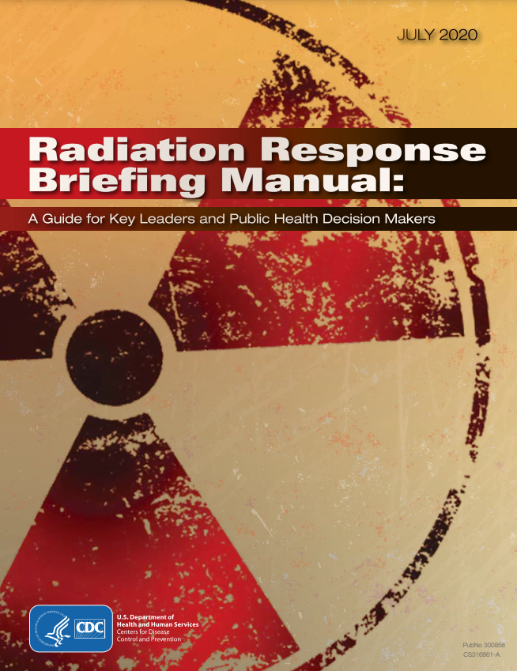
Radiation Response Briefing Manual: A Guide for Key Leaders and Public Health Decision Makers
During a radiation emergency, state and local authorities must swiftly assess the hazard level and promptly issue the suitable protective actions to people in the affected area.
This briefing manual is designed to function as just-in-time training for key decision-makers.
https://www.cdc.gov/nceh/radiation/emergencies/pdf/20_316861-a_radiationresponse-508.pdf
25
Notes:
Description of image: Cover of Briefing Manual: Radiation Response Briefing Manual: A Guide for Key Leaders and Public Health Decision Makers
https://www.cdc.gov/nceh/radiation/emergencies/pdf/20_316861-a_radiationresponse-508.pdf
This briefing manual is intended to serve as a just-in-time training for those who advise key decision makers.

Slide 26
Questions regarding SIP?

Slide 27
Responder Health and Safety
Phase: Early
Objective: Life Safety / Risk Mitigation
Functional Area: Worker Health and Safety
Notes:
This section explores RESPONDER HEALTH AND SAFETY as an EARLY phase response activity. It falls under the LIFE SAFETY / RISK MITIGATION response objectives. The public health functional area is RESPONDER HEALTH AND SAFETY.
Note: This section applies to a number of independent response activities for which public health may have a contributing role in issuing guidance for health and safety measures, including:
Firefighting
Critical infrastructure protection
Search and rescue
The extent to which public health is involved in health and safety efforts will vary by state/jurisdiction. State radiation control authorities will lead the development of health and safety guidance and establish dose and dose rate limits for responders. At a minimum, public health leadership will need to be aware of health and safety concerns and be prepared to communicate guidance and best practices to the public health workforce in the field.

Slide 28
Response Objectives, Functions, and Activities Responder Health & Safety
Notes:
Description of image: A diagram outlining the response objectives and activities by time phase for a radiation emergency. Outlines the early phase activities. Focuses on life safety and risk mitigation activities.

Slide 29
Responder Health and Safety Relationships
Prerequisites
Initial Interagency Modeling and Atmospheric Assessment Center (IMAAC) models received
Dose assessment
Lifting of shelter-in-place for responders
Concurrencies
Field medical care
Dependencies
Evacuation
Population monitoring

Slide 30
Learning Objectives for Responder Health and Safety
Describe methods to determine emergency responders’ doses.
Describe methods to monitor emergency responders’ doses.
Identify appropriate personal protective equipment (PPE) for responders.
Determine responders’ stay times based on the operational environment.
Notes:
The learning objectives for this section are to:
Describe methods to determine emergency responders’ doses.
Describe methods to monitor emergency responders’ doses.
Identify appropriate personal protective equipment (PPE) for responders.
Determine responders’ stay times based on the operational environment.

Slide 31
Who is a Responder?
The Department of Homeland Security (DHS) Health and Safety Planning Guide defines “responders” as a diverse group of individuals crucial to mitigating the potential catastrophic effects of an improvised nuclear device (IND).
This broad definition includes:
Traditional first responders [e.g., emergency medical services (EMS), firefighters, law enforcement, hazardous materials (HAZMAT)]
Emergency management
Public health and medical professionals
Skilled support personnel
Emergency service and critical infrastructure personnel.
Responders may be from government, volunteer, or private sector organizations.
Responders may face a variety of hazards in addition to radiation.
Health and safety efforts need to protect all responders from all hazards.
Notes:
https://www.dhs.gov/publication/ind-health-and-safety-planning-guide

Slide 32
Who is an Emergency Worker?
Emergency workers are defined in Report 179 of the National Council on Radiation Protection and Measurements (NCRP) as:
Workers who would be summoned to aid in the response to a radiological or nuclear incident, recognizing that the majority of emergency workers typically do not encounter radiation levels significantly higher than background levels in their routine jobs.
Emergency workers are not traditional radiation workers (i.e., those whose occupations involve exposure to radiation and who are part of an occupational radiation dose monitoring and protection program).
While the Occupational Safety and Health Administration (OSHA) Standard mandates the monitoring of emergency workers, there is no other regulation requiring the provision of dosimetry for them.
Notes:
We may use worker and responder interchangeably.
https://ncrponline.org/shop/reports/report-no-179-guidance-for-emergency-response-dosimetry-2017/

Slide 33
Background: Responder Health and Safety
Responders are required to use their available resources to evaluate radiation exposure rates, blast damage, critical infrastructure impacts, injuries, and fires in the immediate vicinity of their location.
They should share this information with other responders and a central data collection point, such as an emergency operations center (EOC).
First responders should initiate lifesaving activities as soon as it is safe to do so.
Their initial response priorities, as well as whether they operate from within a sheltered location or outside, will depend on the zone-type they are in, the hazards present in the area, and whether they have access to radiation detection instrumentation.

Slide 34
Responder Health and Safety Partners
In addition to public health, these partners may have a role:
Fire Protection
Law Enforcement
Emergency Medical Services
Urban Search and Rescue
Radiation Control
Emergency Management Agencies
Notes:
PROMPT AUDIENCE: Share information for the first bullet, if they haven’t already done so.
The responsibility for responder health and safety ultimately falls to the parent agency. However, these agencies may look to state radiation control and/or public health to validate personal protective measures and to assess/monitor radiation doses to responders.

Slide 35
What zones are greatest concern for responder health and safety? (areas of concern)
Greatest areas of concern:
Dangerous radiation zone
Exposure rates above 10 R/hr present significant hazard
Exposure rates in the hot zone (0.01 R/hr to 10 R/hr) are also a concern
Moderate damage zone
Apart from radiation hazards, there is also a potential for non-radiation hazards and physical injury
Notes:
Responder health and safety concerns will be greatest for operations in the dangerous radiation zone and moderate damage zones.
Early in the response, the hazard zones will be poorly characterized, and responders could easily enter a dangerous radiation zone without knowing. Furthermore, non-radiation hazards (e.g., fires, chemical releases, falling debris) could be a source of significant injury.
Responders will need to balance the radiation and non-radiation risks with the benefits of the response actions. For example, firefighting may be an essential task to enable people in a certain area to shelter-in-place longer. Similarly, route clearing will be essential to facilitate evacuation.

Slide 36
What zones are greatest concern for responder health and safety? (dosimetry)
Early operational dosimetry will be challenging.
Minimum standard is to monitor doses using environmental models/measurements and time spent in area.
Using representative dosimetry (e.g., one or more shared alarming dosimeters per group) enhances the level of protection.
Notes:
Early in the response, operational dosimetry will be challenging. Tracking doses based on environmental estimates or measurements and operating period is the minimum standard.
If possible, distribute alarming dosimeters and/or direct reading dosimeters as part of a representative dosimetry program (i.e., one dosimeter represents the dose for the group).

Slide 37
What zones are of greatest concern for responder health and safety?
Determination is made based on:
Priority of work
5 rem (50 mSv) – routine occupational exposure
10 rem (100 mSv) – critical infrastructure
25 rem (250 mSv) – lifesaving and protection of large populations
Above 25 rem (250 mSv) – lifesaving and protection of large populations with informed consent of responder
Environmental conditions
The responder’s dose guidelines and measured (or projected) dose rate will determine stay time.
Notes:
How long responders can work in a certain area depends on:
Priority of work (e.g., protecting critical infrastructure vs. environmental monitoring)
This determines the acceptable dose for the task (Table 3-1, 2017 PAG Manual)
Limit 5 rem (50 mSv) for occupational exposure (routine tasks)
Limit 10 rem (100 mSv) for critical infrastructure protection
Limit 25 rem (250 mSv) for lifesaving and protection of large populations
> 25 rem (250 mSv) for lifesaving and protection of large populations - with informed consent from responder
Environmental conditions
The responder’s dose limit and the measured or projected dose rate in an area will determine stay time.

Slide 38
What PPE is necessary to protect from radiological hazards?
Early assessment of airborne radiological hazards is essential to determining respiratory PPE requirements.
For responders who are not traditionally issued respiratory PPE:
Not everyone will have a fit test.
PPE “triage” may be necessary if in short supply.
Other hazards may drive the decision to use respiratory protection, in particular self-contained breathing apparatus (SCBA).
Limited time on air may impact operations.
Be mindful of airborne contamination when refilling SCBA bottles.
Notes:
Response coordinators will need to quickly assess airborne radiological hazards in broad response areas and determine what level of respiratory protection is appropriate/feasible for the operations.
Some responders may not be routinely issued PPE:
Not everyone will be fit tested for the PPE on hand
PPE shortages may require “triage” to determine who is most at risk
While SCBA will not be necessary for radiological hazards, some responders may choose to use it if they have no alternative or if other hazards that warrant that level respiratory protection are present.
SCBA tanks should only be refilled in areas that are free of (or contain minimal) airborne concentrations of radiological material

Slide 39
Rules of Thumb and Dose Limits for Responders
At first sign of a nuclear explosion… | Shelter-in-place at the first sign of an intense flash of light and remain sheltered for at least one hour to let the initial dust settle. Protect your ears from the subsequent blast sound.
Don't rush in | Determine radiation levels first, wear appropriate PPE, define the mission
Stay aware of the wind and weather | Always approach potential fallout zones from the upwind direction
Radiation Dose | The annual occupational dose limit for ionizing radiation is 5 rem (rad or 0.05 Sv). This limit would likely be exceeded in an IND emergency. Minimize exposures to ensure the health and safety of responders. Normal guideline for lifesaving or protection of large populations is 25 rem (rad or 0.25 Sv). Catastrophic event, such as an IND incident, may warrant above 25 rem (rad or 0.25 Sv) for lifesaving.
Exposure Guidelines | Responders anticipated to exceed more than 25% of the occupational dose limit should undergo appropriate monitoring. Ensure that responders possess a comprehensive understanding of the risks, including both short- and long-term effects they may encounter during missions. Additionally, provide training, to the extent feasible, on the actions to be taken in response to these risks. Each responder must make an informed decision as to how much radiation risk they are willing to accept to save lives.
Notes:
Be aware that the wind blows different directions at different altitudes (see slide 32 in the Intro), so contamination from an IND may spread in many directions. Best to approach from local upwind direction, but remain mindful that contamination may be widespread.

Slide 40
Rules of Thumb and Dose Limits for Responders, cont'd
Area for maximizing rescue potential | The portion of the Moderate Damage zone falling outside of the Dangerous Radiation zone offers the best potential for rescuing the most survivable victims.
Recognizing Fallout Particles | Fine, sand-sized grains. However, lack of apparent fallout does not suggest lack of radiation. Continued radiation monitoring is required.
Fallout Decays Rapidly | 7-10 Rule: With every sevenfold increase in time after detonation, there is a tenfold decrease in the radiation rate. Therefore, after seven hours, the radiation rate is only 10% of the original, and after 49 hours (7 x 7 = 49), it reduces to 1%.
Decision Dose or Turn-back Dose | When approaching or surveying the scene, the 10 R/h (0.1 Gy/h) point normally indicates that workers should return to a safe area, unless they are undertaking a sufficiently justified mission to validate the exposure.
Acute Radiation Syndrome | Nausea, vomiting or diarrhea indicates exposure of 100 rad (1 Gy) or higher. Exit radiation area immediately and seek medical care.
Decontamination* | Remove all outer clothing and footwear. Shower if possible, or wipe skin and hair with moist towelettes.
*For Medical Responders:
Provide life-saving medical care before decontamination.
Do not forget -- all of the other hazards that go with a catastrophic event will still exist.

Slide 41
Responder Health and Safety Resources

Slide 42
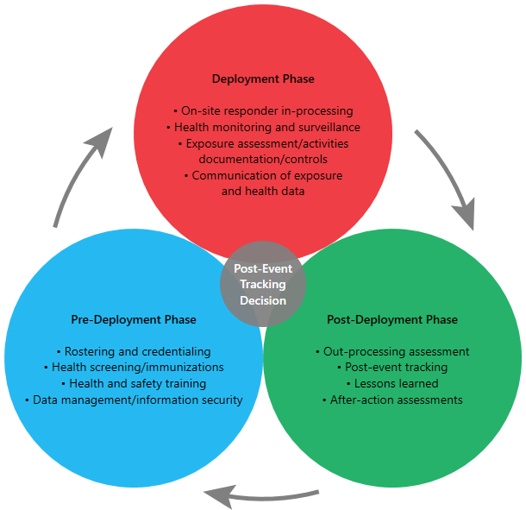

Emergency Responder Health Monitoring and Surveillance™ (ERHMSTM)
National Institute for Occupational Safety and Health (NIOSH) worked with the U.S. National Response Team (NRT) and federal agencies, state health departments, labor unions, and volunteer emergency responder groups to develop the Emergency Responder Health Monitoring and Surveillance™ (ERHMSTM) framework.
https://www.cdc.gov/niosh/erhms/default.html
Notes:
Description of image: ERHMS phase schematic. The post-event tracking decision happens in 3 phases: Pre-Deployment Phase, Deployment Phase, and Post-Deployment phase.
https://www.cdc.gov/niosh/erhms/default.html
ERHMS system is a health monitoring and surveillance framework that includes recommendations and tools specific to protect emergency responders during all phases of a response, including pre-deployment, deployment, and post-deployment phases.
The intent of ERHMS™ is to identify exposures and/or signs and symptoms early in the course of an emergency response, prevent or mitigate adverse physical and psychological outcomes, ensure workers maintain their ability to respond effectively and are not harmed during response work, evaluate protective measures, and identify responders for medical referral and possible enrollment in a long-term health surveillance program.

Slide 43
Responder Health and Safety References

Slide 44
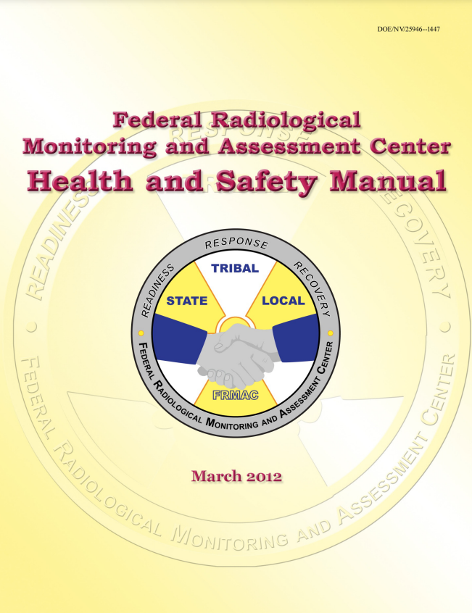
Federal Radiological Monitoring and Assessment Center Health and Safety Manual
This document establishes radiological health and safety protection plans for the Federal Radiological Monitoring and Assessment Center (FRMAC) and complies with all applicable regulations.
https://www.nnss.gov/docs/docs_FRMAC/Health%20and%20Safety%20Manual%202012.pdf
Notes:
Description of image: Document cover, Federal Radiological Monitoring and Assessment Center Health and Safety Manual
https://www.nnss.gov/docs/docs_FRMAC/Health%20and%20Safety%20Manual%202012.pdf

Slide 45
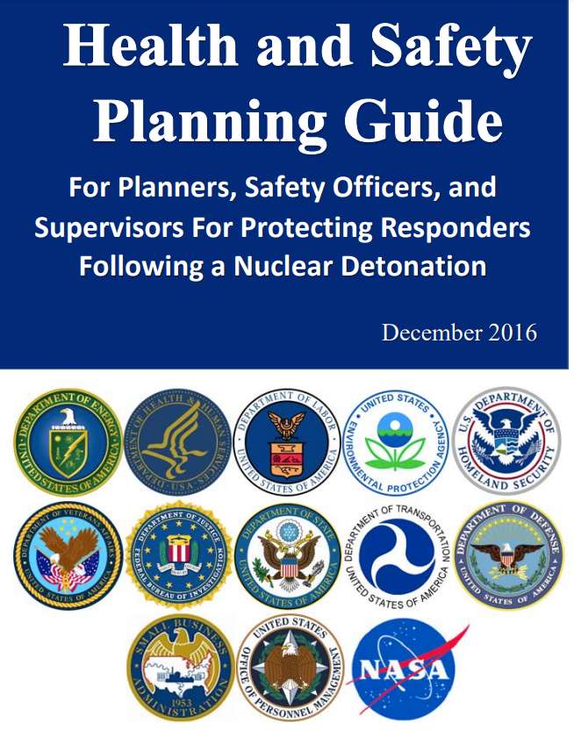
Planning Guide for Health and Safety: For Planners, Safety Officers, and Supervisors to Safeguard Responders Post-Nuclear Detonation
This guide aims to assist in maintaining the health and safety of response personnel, ensuring the continuity of lifesaving efforts and critical infrastructure support throughout the duration of the emergency.
https://www.dhs.gov/publication/ind-health-and-safety-planning-guide
Notes:
Description of image: Document cover, Health and Safety Planning Guide
https://www.dhs.gov/publication/ind-health-and-safety-planning-guide

Slide 46
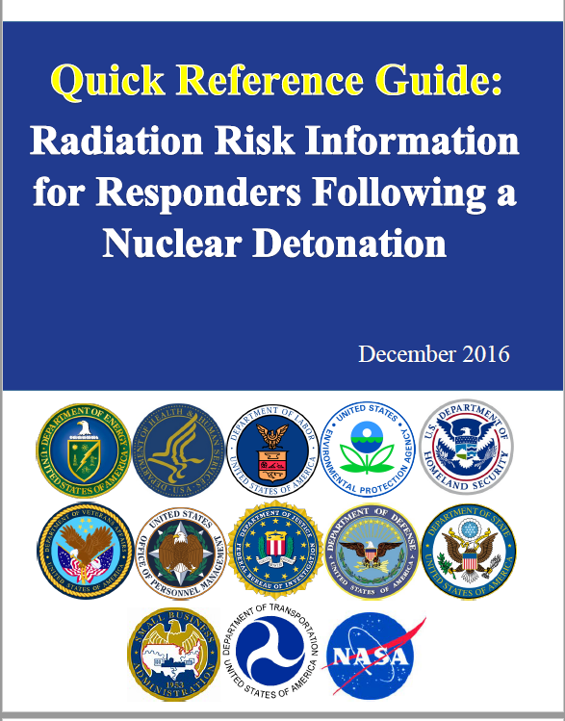
Quick Reference Guide: Radiation Risk Information for Responders Following a Nuclear Detonation
This document provides responders with explicit guidance and recommendations concerning the radiation risk involved in responding to an improvised nuclear device (IND) event. It aims to empower responders to safeguard themselves from the effects of the IND.
It provides responders with basic information essential for the initial 24 to 72 hours following an extreme event -- a nuclear detonation.
https://www.dhs.gov/sites/default/files/publications/Quick%20Reference%20Guide%20Final.pdf​
Notes:
Description of image: Document Cover, Quick Reference Guide: Radiation Risk Information for Responders Following a Nuclear Detonation
https://www.dhs.gov/sites/default/files/publications/Quick%20Reference%20Guide%20Final.pdf

Slide 47
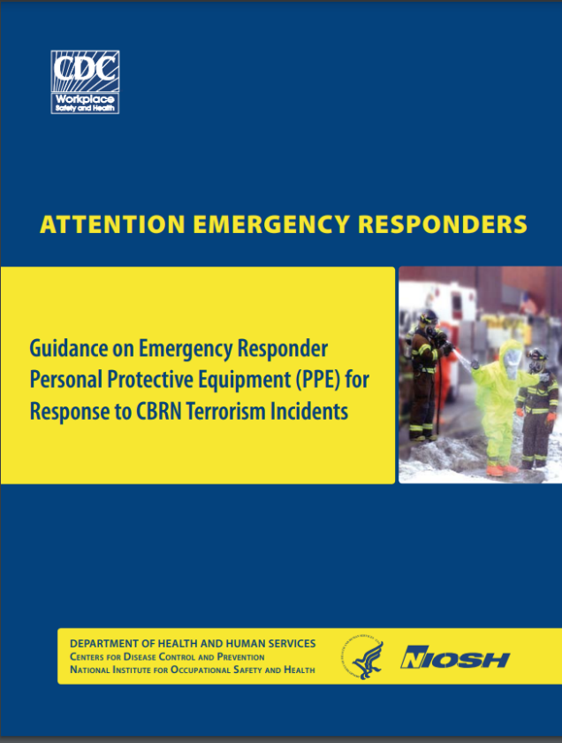
Attention Emergency Responders: Guidance on Emergency Responder PPE for Response to CBRN Terrorism Incidents
This document supplies local, state, and Federal emergency response entities with comparative information on OSHA/EPA Protection Levels A, B, and C in relation to DHS-adopted PPE performance-based standards for responding to terrorism incidents involving CBRN hazards.
Photo credit: CDC
https://www.cdc.gov/niosh/docs/2008-132/default.html
​
Notes:
Description of image: Document cover, Guidance on Emergency Responder PPE
https://www.cdc.gov/niosh/docs/2008-132/default.html
https://www.cdc.gov/niosh/docs/2008-132/pdfs/2008-132.pdf?id=10.26616/NIOSHPUB2008132

Slide 48
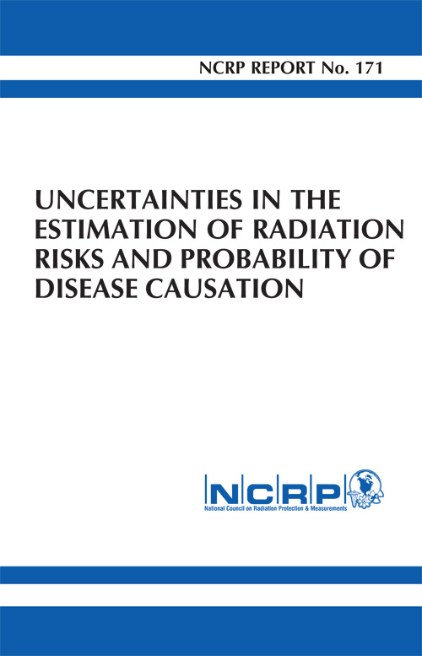
NCRP Report, No. 171, Uncertainties in the Estimation of Radiation Risks and Probability of Disease Causation
This report examines the various types and magnitudes of uncertainties inherent in the risk assessment process for cancer, heritable, and noncancer effects resulting from radiation exposure.
https://ncrponline.org/shop/reports/report-no-171-uncertainties-in-the-estimation-of-radiation-risks-and-probability-of-disease-causation/
Notes:
Description of image: Document cover, NCRP Report No. 171
https://ncrponline.org/shop/reports/report-no-171-uncertainties-in-the-estimation-of-radiation-risks-and-probability-of-disease-causation/

Slide 49
Questions regarding Responder Health and Safety?

Slide 50
Evacuation
Phase: Early / Intermediate
Objective: Risk Mitigation
Functional Area: Risk Communication
Notes:
This section explores EVACUATION as an EARLY phase response activity. It falls under the RISK MITIGATION response objectives. The public health functional area is RISK COMMUNICATION.
Note: In this context, evacuation refers to a planned/controlled/informed/guided process intended to mitigate risk to people by moving them out of areas with high radiation levels.

Slide 51
Response Objectives, Functions, and Activities Evacuation
Notes:
Description of image: A diagram outlining the response objectives and activities by time phase for a radiation emergency. Outlines the early phase risk mitigation activities.

Slide 52
Evacuation Learning Objectives
Describe factors that influence the timing of evacuation recommendations/decisions.
Identify the factors considered when determining a safe evacuation route.
Discuss the communication requirements for the general public in the context of evacuation.
Notes:
The learning objectives for this section are:
Describe the factors that influence the timing of evacuation recommendations.
Identify the key factors that are taken into account when determining a safe evacuation route.
Discuss the communication needs regarding guided evacuation for the general public.

Slide 53
Evacuation Relationships
Prerequisites
Route clearing operations
Shelter-in-place lifted
Population monitoring
Concurrencies
Population monitoring
Public shelters
Dependencies
Relocation
Population monitoring

Slide 54
Evacuation Key Activities
Early-phase infrastructure restoration will encompass clearing debris and ensuring the accessibility of major roadways for effective evacuation operations.
Emphasize the priority of relocating individuals away from significant hazards or obstacles that pose a threat to their lives (e.g., fire, high radiation levels, impassable exit points, debris). Direct them generally toward areas where Supporting Jurisdictions can safely receive them.
Instruct the public to conduct rapid, dry self-decontamination, if they have not already.
Identify and communicate evacuation priorities and routes.
Prepare to receive and care for evacuees.
Don't forget there will be shadow evacuees.
Shadow evacuees are individuals who voluntarily leave areas that are not officially designated for evacuation.
Shadow evacuees could congest roadways and impede the egress of those evacuating from areas at risk.
Notes:
https://pubmed.ncbi.nlm.nih.gov/25902297/

Slide 55
Evacuation Partners
In addition to public health, these partners may have a role:
Emergency Medical Service (EMS)
Volunteers/Non-Governmental Organizations (NGOs) [e.g., Medical Reserve Corps (MRC), Red Cross]
Disaster Medical Assistance Teams (DMAT)
Department of Defense (DOD)/National Guard
Hospital emergency managers

Slide 56
Which areas are safe to evacuate?
Evacuation priorities will be dependent on the:
Extent of damage and road/route congestion
Radiation levels along the evacuation route
In many cases, it may be better for people to shelter-in-place longer.
Provides the opportunity to clear and prepare evacuation routes
Allows for additional radioactive decay over time.

Slide 57
Where Does Evacuation Occur?
Areas where shelter-in-place has been in effect.
Areas where radiation levels are low enough to permit safe evacuation.

Slide 58
How do you effectively communicate where people need to go?
Use established emergency communication channels/systems.
Collaborate with organizations to distribute information to hard-to-reach and limited English proficiency populations
Messages should include:
Why evacuate
Which areas are being evacuated
When the evacuation will start
How the evacuation will take place (e.g., personal vehicles, buses, trains)
Where to go following evacuation [e.g., community reception centers (CRCs), shelters]
Where NOT to go (i.e., areas that still have dangerously high radiation levels)
What to bring (medicines, clothes, documents, etc.)
Notes:
Risk communicators should plan to use all available emergency communications channels/systems.
Detailed messages will include:
What areas are being evacuated
When the evacuation will start
How the evacuation will take place (e.g., POV, buses, trains)
Where to go if you self-evacuate (e.g., CRC locations)
Where NOT to go (i.e., areas that still have dangerously high radiation levels
See messages 24 & 25 for some pre-scripted evacuation messages
https://www.fema.gov/sites/default/files/documents/fema_improvised-nuclear-device_communicating-aftermath_june-2013.pdf
Sample Nuclear Detonation/Improvised Nuclear Device Social Media Messages for Evacuation Social Media Messages Page N-15
DHS Office of Public Affairs (fema.gov)

Slide 59
Which evacuation routes are safe to use?
Goal is to minimize radiation dose during evacuation
Emergency managers must consider:
Radiation levels along evacuation route
Estimated time people will be on that route
The inherent risk of evacuation vs. risk from radiation dose
Management of special populations (e.g., hospitals, nursing homes, prisons)
Other hazards
Notes:
Goal is to minimize radiation dose during evacuation
Dose is dependent on radiation dose rate and length of time exposed
Emergency managers must consider:
Radiation levels along evacuation route
Estimated time people will be on that route
The inherent risk of evacuation vs. radiation dose
In some cases, the additional radiation dose may be less dangerous than the risk from evacuation (e.g., Fukushima)

Slide 60
Evacuation References

Slide 61
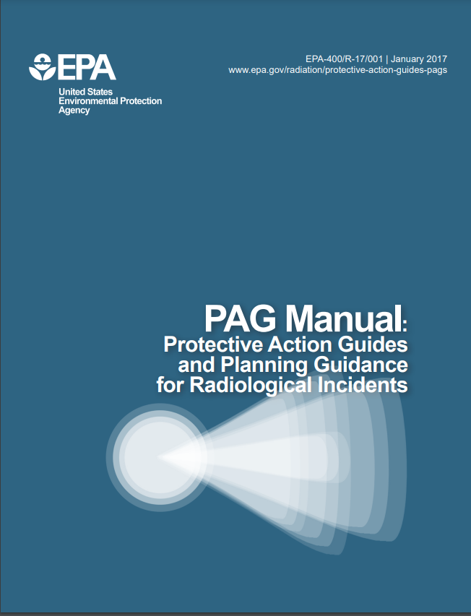
PAG Manual: Protective Action Guides and Planning Guidance for Radiological Incidents
The U.S. Environmental Protection Agency (EPA) published this Manual to aid public officials in planning for emergency responses to radiological incidents.
This Manual provides radiological protection criteria applicable to all incidents that necessitate consideration of protective actions.
https://www.epa.gov/sites/default/files/2017-01/documents/epa_pag_manual_final_revisions_01-11-2017_cover_disclaimer_8.pdf
Notes:
Description of image: Document cover, PAG Manual
https://www.epa.gov/sites/default/files/2017-01/documents/epa_pag_manual_final_revisions_01-11-2017_cover_disclaimer_8.pdf
2.2.2 Evacuation vs. Sheltering-in-Place

Slide 62
Questions regarding Evacuation?

Slide 63
Disclaimer
The findings and conclusions presented here are those of the authors and may not necessarily reflect the official position of the Centers for Disease Control and Prevention/the Agency for Toxic Substances and Disease Registry.

Slide 64
508 Compliance Disclaimer
CDC cannot verify the compliance of documents produced by outside agencies and companies.
If you have problems accessing them, please contact the vendor directly or file an accessibility report and mention the name of the file, so we can assist you.
https://www.cdc.gov/other/disclaimer.html

